Slide 1
Molecular Mechanics Poisson Boltzmann Surface Area
MMPBSA

Slide 2
how to estimate free energies?
ΔG_{free}
ΔG_{bound}
(1) Use free energy perturbation methods to estimate relative free energies
ΔΔG =ΔG_{free} - ΔG_{bound}

Slide 3
how to estimate free energies?
(2) Estimate potential of mean force along pathway? (but, what’s the pathway?)
ΔG_{free}
ΔG_{bound}
?
(1) Use free energy perturbation methods to estimate relative free energies
ΔΔG =ΔG_{free} - ΔG_{bound}
ΔG?

Slide 4
how to estimate free energies?
(2) Estimate potential of mean force along pathway? (but, what’s the pathway?)
ΔG_{free}
ΔG_{bound}
?
(1) Use free energy perturbation methods to estimate relative free energies
ΔΔG =ΔG_{free} - ΔG_{bound}
ΔG?
(3) Use molecular dynamics to sample configurations from each representative state
estimate free energy at each state as an average of the free energy of the sampled configurations
how do we estimate this free energy???

Slide 5
Approach #1: Find “representative” structures and minimize energy…

Slide 6
Approach #1: Find “representative” structures and minimize energy…
Problem: Energy surface is rough; get trapped in local minima

Slide 7
Approach #1: Find “representative” structures and minimize energy…
Approach #2: Raw potential energies…
Problem: Energy surface is rough; get trapped in local minima
Problem? Large standard deviation, dominated by water-water

Slide 8
Approach #1: Find “representative” structures and minimize energy…
Approach #2: Raw potential energies…
(but it works: Linear response; ½ solute-solvent interaction energy)
Problem: Energy surface is rough; get trapped in local minima
Problem? Large standard deviation, dominated by water-water

Slide 9

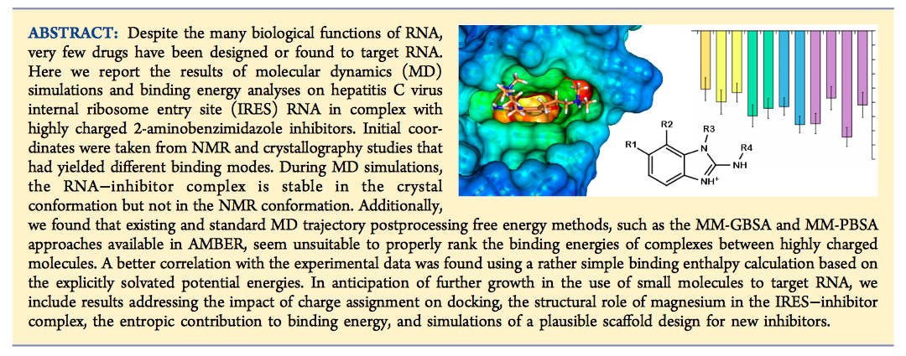

Slide 10
Approach #1: Find “representative” structures and minimize energy…
Approach #2: Raw potential energies…
(but it works: Linear response; ½ solute-solvent interaction energy)
Approach #3: MM-PBSA
Problem: Energy surface is rough; get trapped in local minima
Problem? Large standard deviation, dominated by water-water

Slide 11
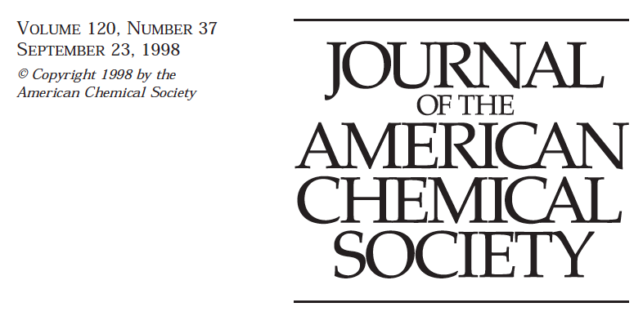
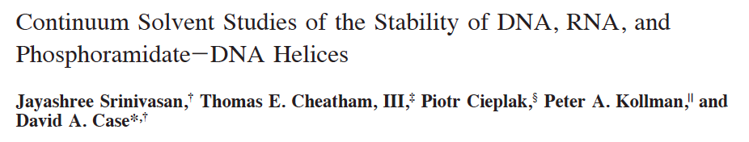

Slide 12
crude estimation of the relative free energy difference between “metastable” states from molecular dynamics simulations in explicit solvent
assume continuum solvent, average over configurations
no cutoff
from harmonic approximation
Poisson-Boltzmann or generalized Born plus a solvent accessible surface area term

Slide 13
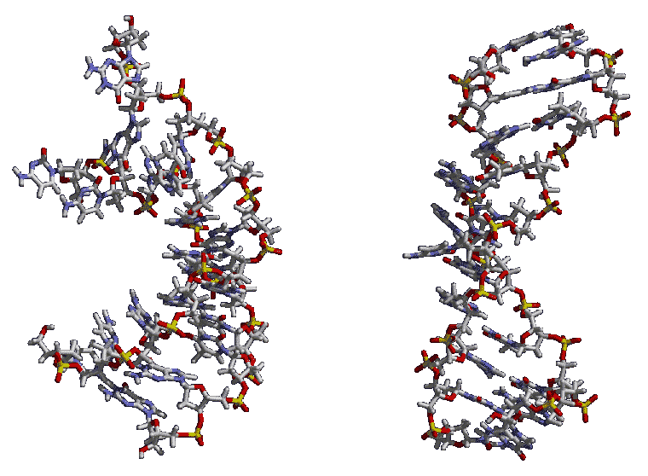
A brief history of molecular dynamics simulation…
1976-1985: Dark Ages

Slide 14
A brief history of molecular dynamics simulation…
1976-1985: Dark Ages
1985-1994: ΔG (FEP)
ΔG₁
E + S₁ ES₁
E + S₂ ES₂
ΔG₃
ΔG₄
ΔG₂

Slide 15
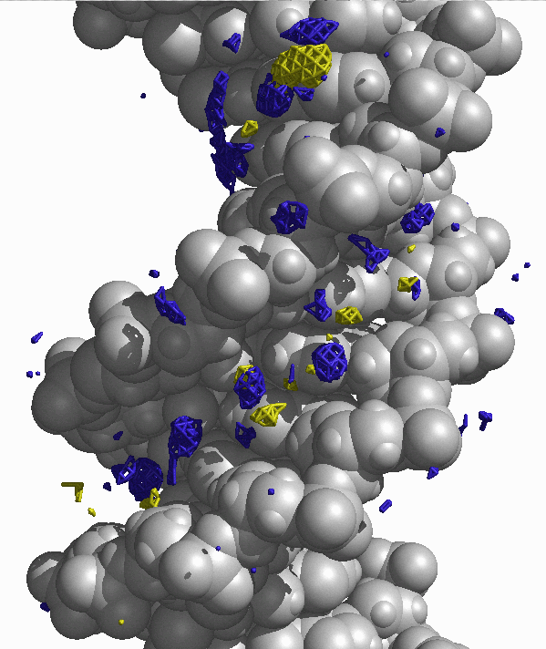
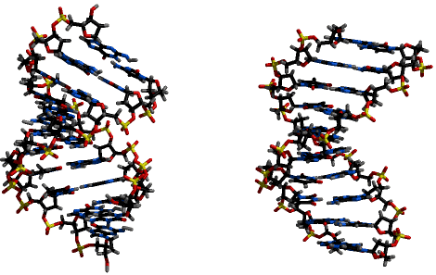
A brief history of molecular dynamics simulation…
1976-1985: Dark Ages
1985-1994: ΔG (FEP)
1995-1998: structure
E + S₁ ES₁
E + S₂ ES₂

Slide 16
A brief history of molecular dynamics simulation…
1976-1985: Dark Ages
1985-1994: ΔG (FEP)
1995-1998: structure
1998- now : structure + ΔG ???
E + S₁ ES₁
E + S₂ ES₂
Acc. Chem. Res. 33, 889-897 (2000)
“Calculating structures and free energies of complex molecules: Combining molecular mechanics and continuum models”

Slide 17
are these crude estimates worth it? can we aspire to < 1.0 kcal/mol accuracy?
Drawbacks:
How to include role of “specific” ion or water interaction?
How to estimate solute entropy accurately (i.e. unfolding)
Need detailed parameterization of continuum model to balance the molecular mechanical force field

Slide 18
are these crude estimates worth it? Yes! can we aspire to < 1.0 kcal/mol accuracy? No.
Drawbacks:
How to include role of “specific” ion or water interaction?
How to estimate solute entropy accurately (i.e. unfolding)
Need detailed parameterization of continuum model to balance the molecular mechanical force field
… but, for little additional cost, we can get a representation of the (free) energetics!!!
Evaluation of model structures: which model is more stable?
Evaluation of force fields: does the force field have the right balance?
Insight into subtle energetic balances

Slide 19
crude estimation of the relative free energy difference between “metastable” states from molecular dynamics simulations in explicit solvent
A-RNA vs. B-RNA ✓
B-DNA vs. A-DNA ✓
phosphoramidate DNA ✓
RNA hairpin loops ✓
dA₁₀-dT₁₀ vs. dG₁₀-dC₁₀ ✓
We have a means to evaluate the relative stability of our MD generated models!
Srinivasan et al. JACS (1998)
Srinivasan et al. JBSD (1998)
Cheatham et al. JBSD (1998)
Kollman et al. Acc. Chem. Res (2000)

Slide 20
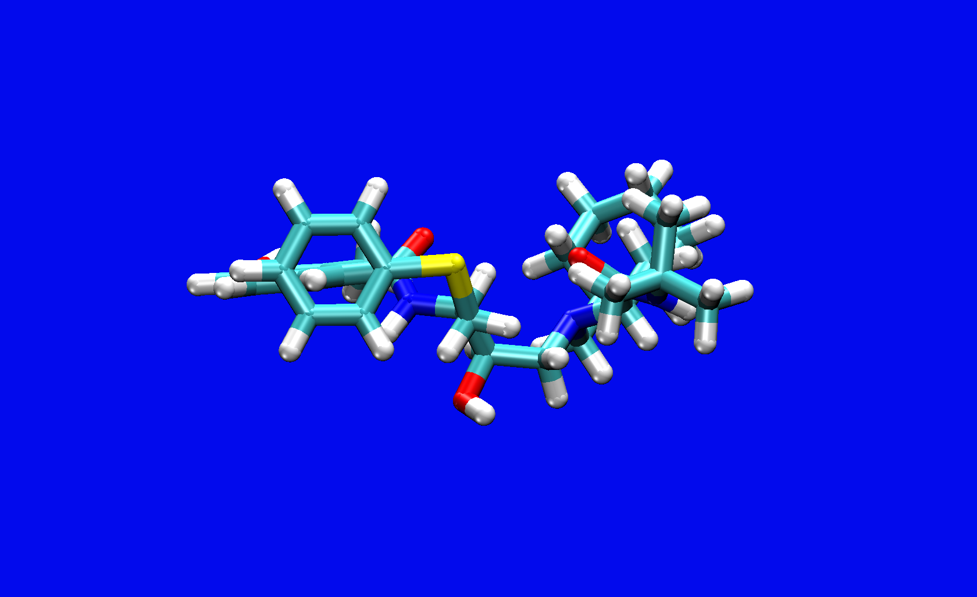
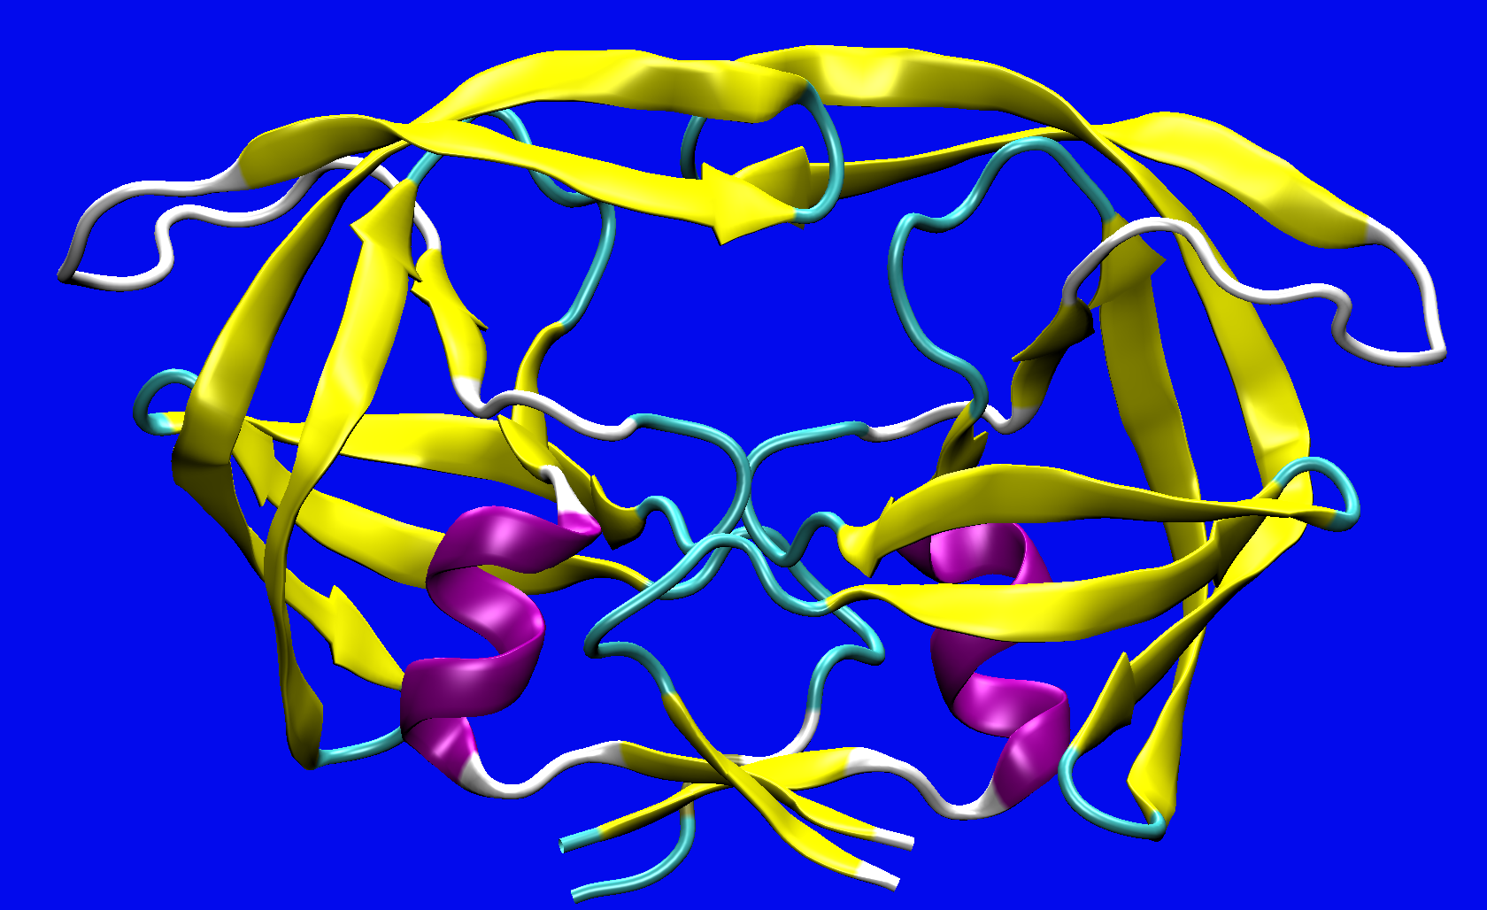
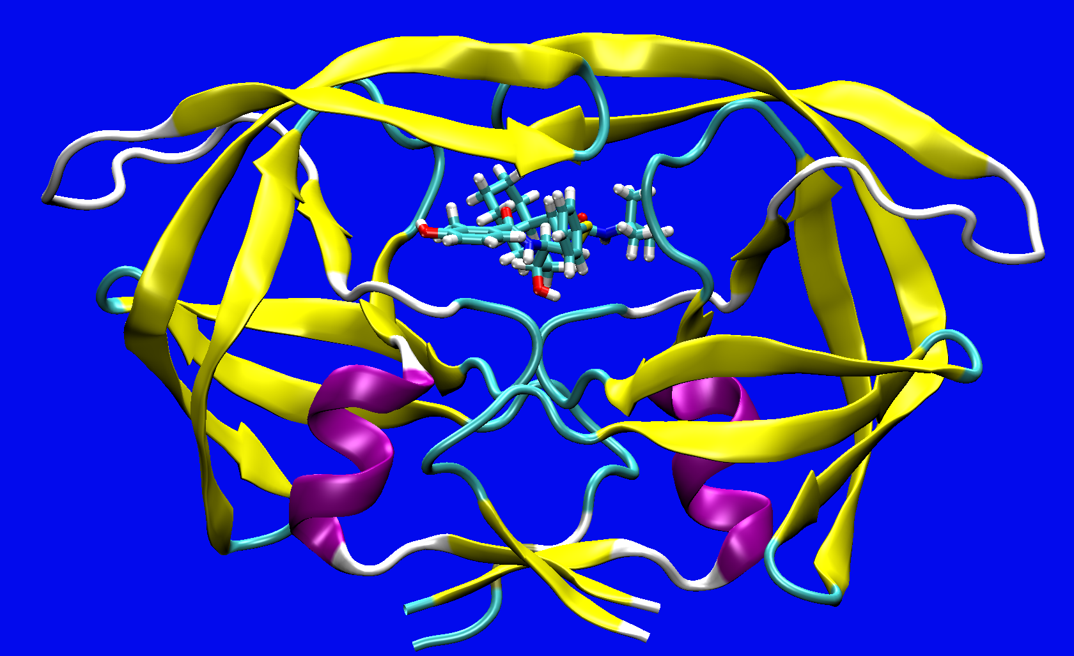
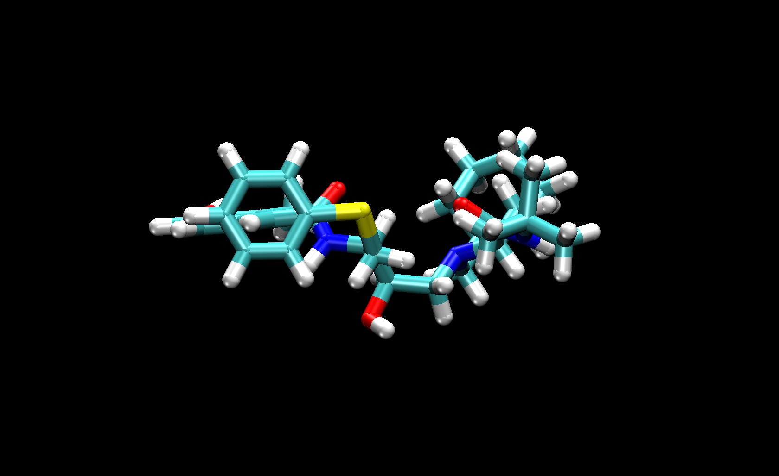
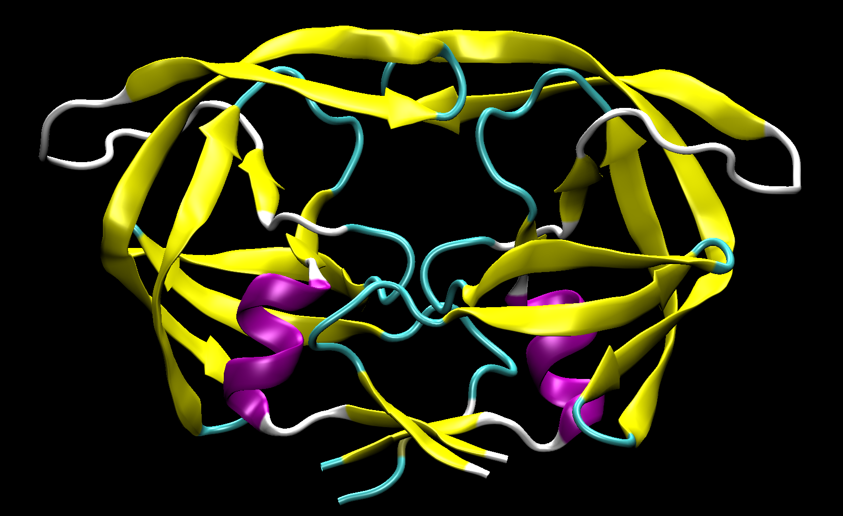
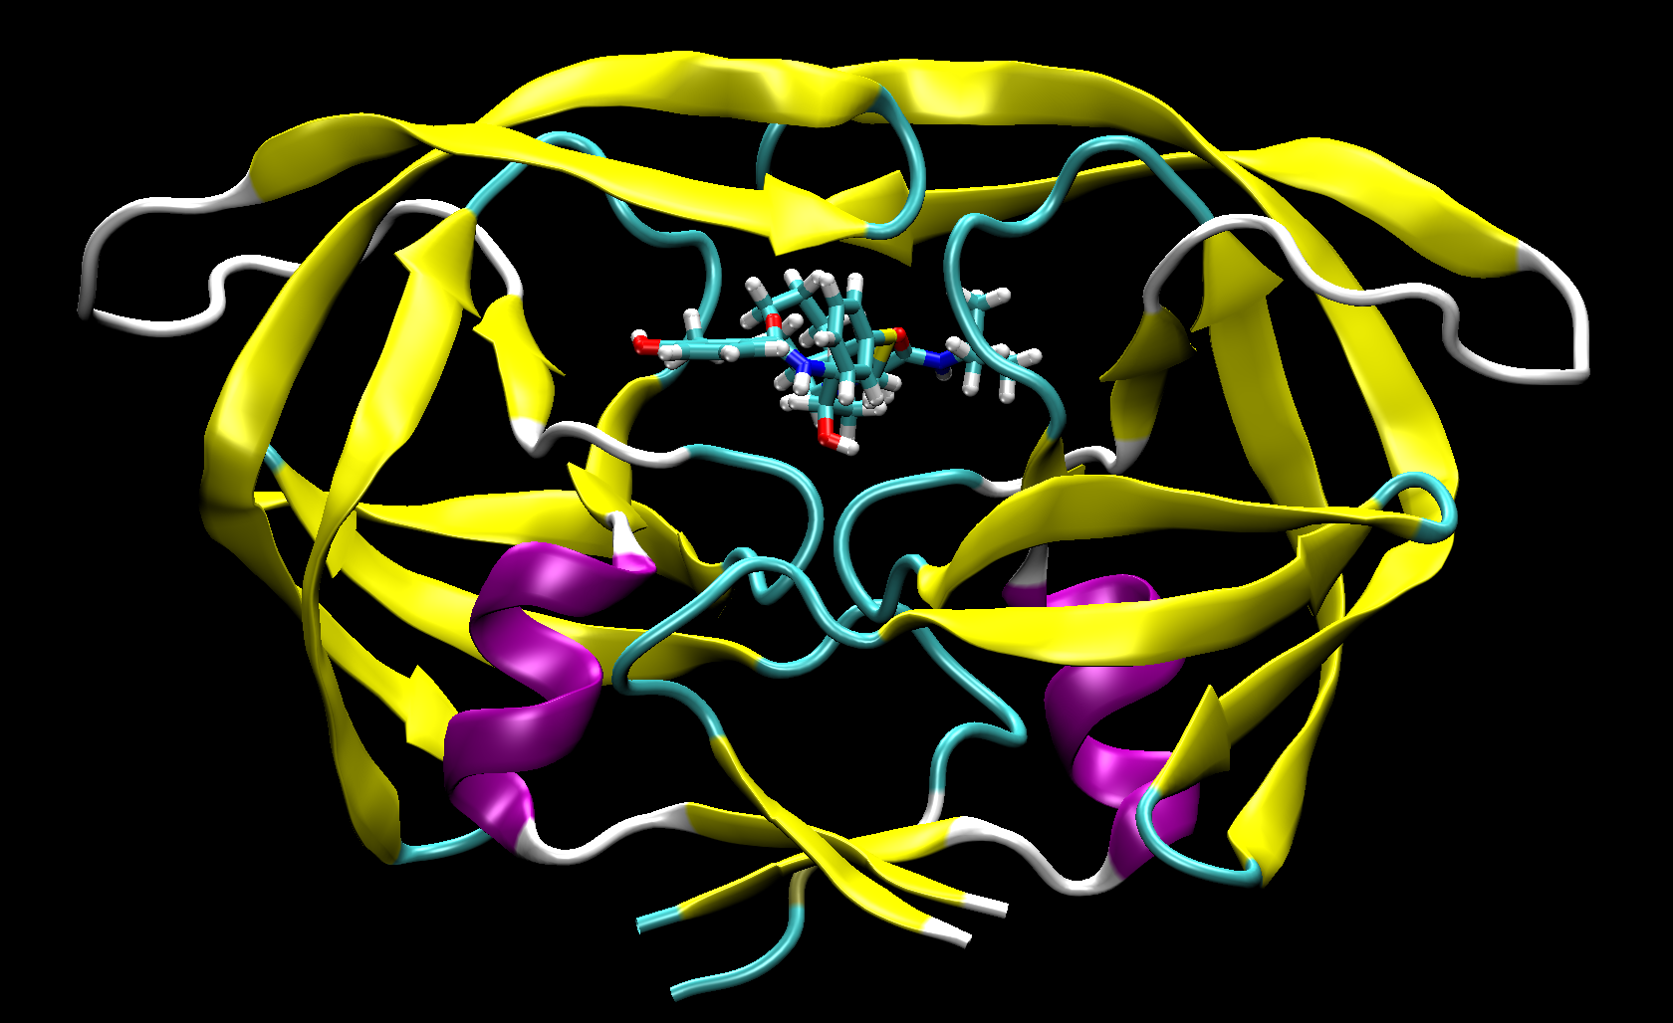
Molecular Mechanics Poisson-Boltzmann Surface Area
∆G_{Solv, Bind}
∆G_{Solv, Ligand}
∆G_{Solv, Receptor}
∆G_{Solv, Complex}
∆G_{Vac, Bind}
∆G_{Solv, Bind} = ∆G_{Vac, Bind} + ∆G_{Solv, Complex} – (∆G_{Solv, Receptor} + ∆G_{Solv, Ligand})

Slide 21
Molecular Mechanics Poisson-Boltzmann Surface Area Cont’d

Slide 22
single vs. multiple trajectory?
∆G_{Solv, Bind}
∆G_{Solv, Ligand}
∆G_{Solv, Receptor}
∆G_{Solv, Complex}
∆G_{Vac, Bind}
∆G_{Solv, Bind} = ∆G_{Vac, Bind} + ∆G_{Solv, Complex} – (∆G_{Solv, Receptor} + ∆G_{Solv, Ligand})

Slide 23
Can we use this crude (free) energetic analysis to estimate melting temperature (i.e. the free energy of duplex formation)?
Use configurations sampled from molecular dynamics trajectory of the double strand as guess of the single stranded conformation...
poly(dA)
poly(dT)
molecular dynamics of duplex
molecular dynamics of single strands
+
-
Note: we cannot ignore rotational/translational entropy components
G_{polyT} + G_{polyA} - G_{polyT-polyA}

Slide 24
Can we use this crude (free) energetic analysis to estimate melting temperature (i.e. the free energy of duplex formation)?
solute (vibrational) entropic component
ΔG_{solvation} + <E_{solute}>
rotational and translational entropic components (at 300K)
G_{polyA-polyT} - G_{polyA} - G_{polyT} = -33.7 + 4.8 + 27.8 = -1.1 kcal/mol
G_{polyG-polyC} - G_{polyG} - G_{polyC} = -58.9 + 7.5 + 27.8 = -23.6 kcal/mol
ΔG_{GC-AT} ~ -22.5 compared to ~ -8.1 using Santa Lucia tables*
*SantaLucia Jr, J., & Hicks, D. (2004)
The thermodynamics of DNA structural motifs
Annu. Rev. Biophys. Biomol. Struct., 33, 415-440.
*SantaLucia, J. (1998). A unified view of polymer, dumbbell,
and oligonucleotide DNA nearest-neighbor thermodynamics
Proceedings of the National Academy of Sciences, 95(4), 1460-1465.
https://eead-csic-compbio.github.io/bioinformatica_estructural/node27.html

Slide 25
Can we use this crude (free) energetic analysis to estimate melting temperature (i.e. the free energy of duplex formation)?
solute (vibrational) entropic component
ΔG_{solvation} + <E_{solute}>
rotational and translational entropic components (at 300K)
G_{polyA-polyT} - G_{polyA} - G_{polyT} = -33.7 + 4.8 + 27.8 = -1.1 kcal/mol
G_{polyG-polyC} - G_{polyG} - G_{polyC} = -58.9 + 7.5 + 27.8 = -23.6 kcal/mol
ΔG_{GC-AT} ~ -22.5 compared to ~ -8.1 using Santa Lucia tables
d[CGCGCGCGCG]₂ : -46.7
d[ACCCGCGGGT]₂ : -48.8

Slide 26
Does the single strand conformation resemble that of the duplex?
molecular dynamics of single strands

Slide 27
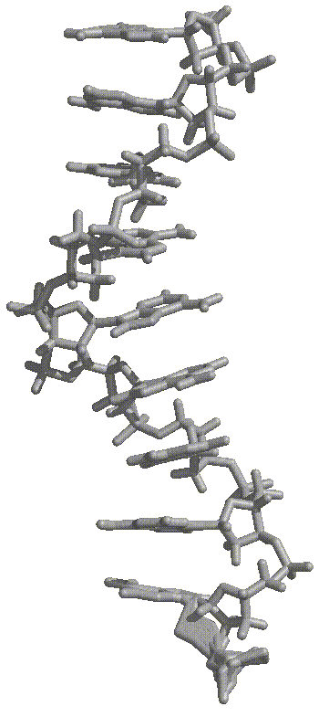
10-mer poly(A) single strand
~6 ns average structure
Is this due to artifacts from true periodicity?

Slide 28
10-mer poly(A) single strand
~6 ns average structure
What about polyT, polyG and polyC?

Slide 29
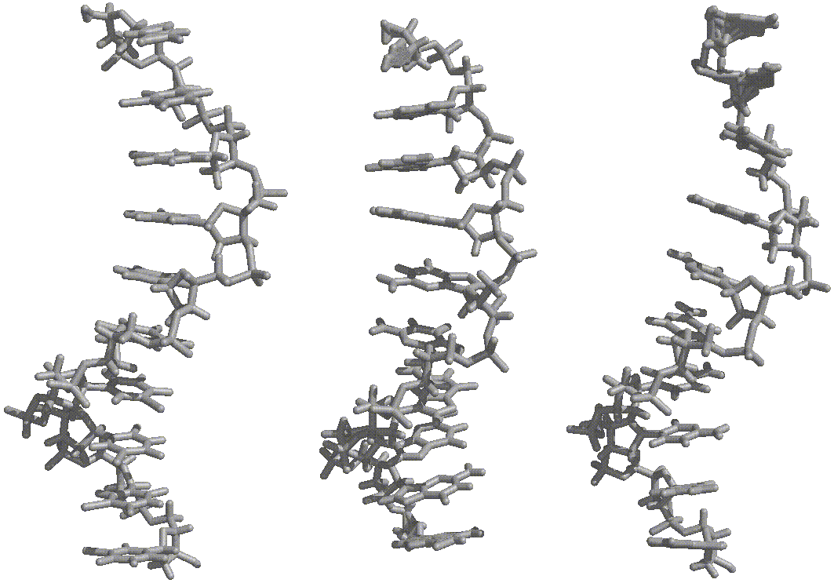
poly(T) ~5.2ns
poly(G) ~3.6ns
poly(C) ~2.9ns

Slide 30
Can we use this crude (free) energetic analysis to estimate melting temperature (i.e. the free energy of duplex formation)?
solute (vibrational) entropic component
ΔG_{solvation} + <E_{solute}>
rotational and translational entropic components (at 300K)
G_{polyA-polyT} - G_{polyA} - G_{polyT} = -33.7 + 4.8 + 27.8 = -1.1 kcal/mol
G_{polyA-polyT} - G_{polyA} - G_{polyT} = -12.8 + 4.8 + 27.8 = +19.8 kcal/mol
☹
G_{polyG-polyC} - G_{polyG} - G_{polyC} = -58.9 + 7.5 + 27.8 = -23.6 kcal/mol
G_{polyG-polyC} - G_{polyG} - G_{polyC} = -32.1 + 7.5 + 27.8 = +3.2 kcal/mol
more “realistic” sampling of unfolded (single strand) states
But are these sampled states representative?
[or can we sample relevant states?]

Slide 31
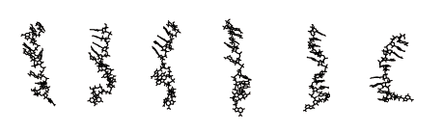
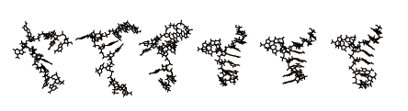
Can we refold “unfolded” DNA single strands?
0 ps 500 ps 1000 ps 1633 ps 2283 ps 2711 ps
the structure is almost completely stacked except for a 2 base bulge...
0 ps 250 ps 750 ps 1478 ps 2128 ps 2708 ps
The top five bases are stacked as are the next four.

Slide 32
polyA 10-mer single strands
snapshots at ~15 ns

Slide 33
Applications
The distinction between “Receptor” and “Ligand” is somewhat arbitrary, and MM-PBSA has been tested on the following:
Protein-DNA binding
Protein-protein binding
Protein–ligand binding
DNA-RNA stability
MM-PBSA has been to shown to produce results in excellent agreement to experimental data in many studies*
*But has failed in other studies…

Slide 34
Method Evaluation
Pros
Cons
Computationally less rigorous than TI or FEP
Allows flexible protein
Applicable to a variety of systems
Yields absolute free energies?
Often all structures are derived from 1 simulation
Relies on tricky entropy estimations
May depend on cancellation of errors
Homeyer, N.; Gohlke, H. Molecular Informatics 2012, 31, 114–122

Slide 35
Programs in AMBER for MMPBSA
mm_pbsa.pl
Perl version (modified and more complicated original version)
MMPBSA.py
Python version (newer version)
MMPBSA
cpptraj
nab
sander

Slide 36
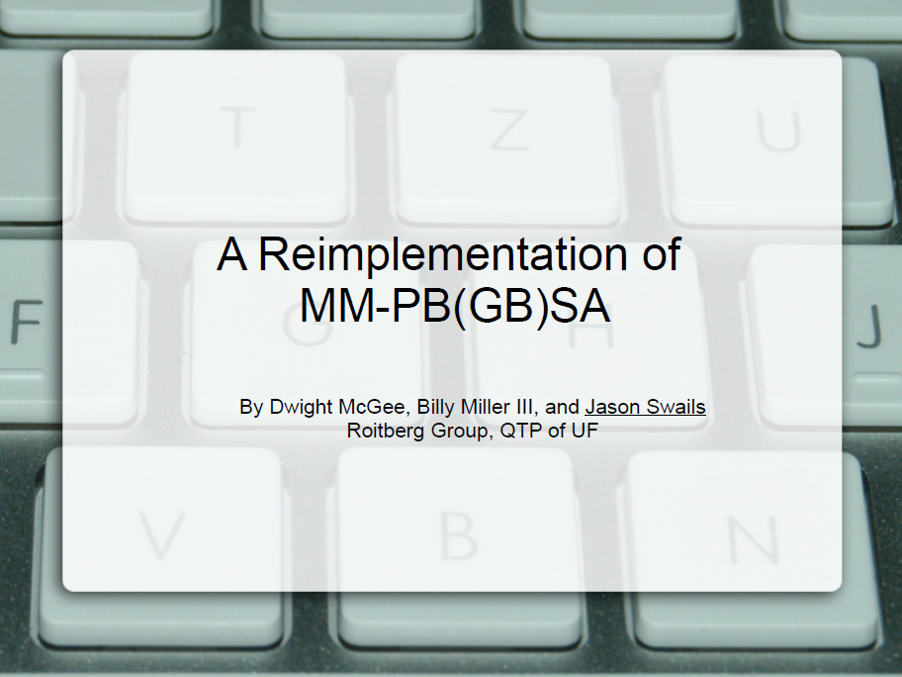

Slide 37
MMPBSA.py
usage: MMPBSA.py [-h] [-v] [--input-file-help] [-O] [-prefix <file prefix>]
[-i FILE] [-xvvfile XVVFILE] [-o FILE] [-do FILE] [-eo FILE]
[-deo FILE] [-sp <Topology File>] [-cp <Topology File>]
[-rp <Topology File>] [-lp <Topology File>]
[-mc <Topology File>] [-mr <Topology File>]
[-ml <Topology File>] [-srp <Topology File>]
[-slp <Topology File>] [-y [MDCRD [MDCRD ...]]]
[-yr [MDCRD [MDCRD ...]]] [-yl [MDCRD [MDCRD ...]]]
[-make-mdins] [-use-mdins] [-rewrite-output] [--clean]

Slide 38
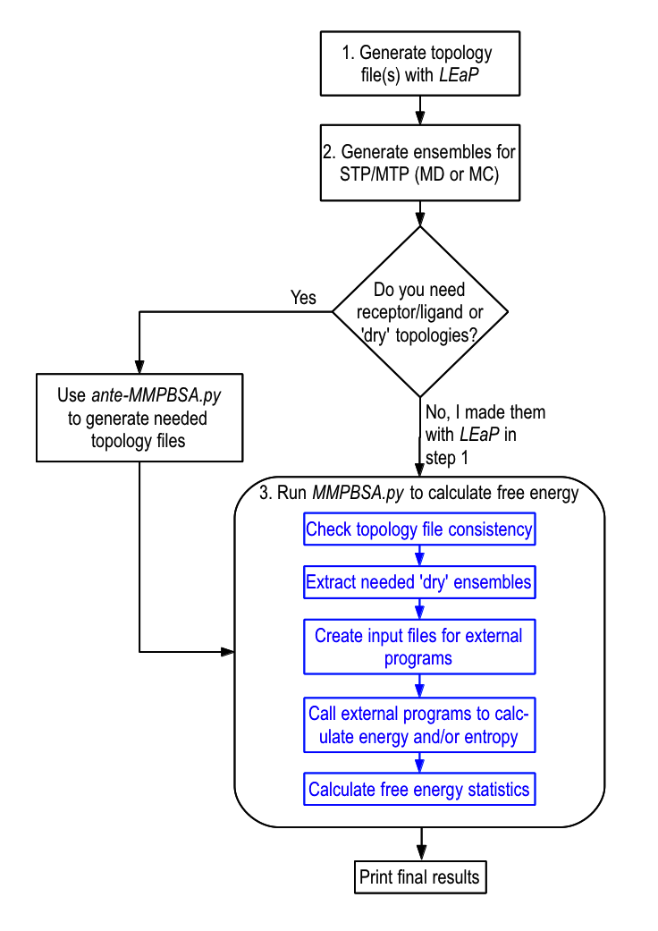
MMPBSA.py Workflow

Slide 39
General Features of MMPBSA.py
Calculation of the Solvation Free Energy
Poisson Boltzmann (PB)
Generalized Born (GB)
The least computationally expensive
Reference Interaction Site Model (RISM)
Entropy Calculations
Normal Mode Analysis
Quasi-harmonic Analysis
The least computationally expensive
Free Energy Decomposition
Per-Residue
Pair-Residue
Alanine Scanning
ante-MMPBSA.py
Helpful in generating all the necessary topology files for MMPBSA.py
Mpi4py
Calculations can be run in parallel

Slide 40
Example Input for MMPBSA.py
mmpbsa input
&general
interval=1, netcdf=1,
entropy=1, use_sander=1,
/
&gb
igb=8
/
*Noticed that the input is sander-like

Slide 41
MMPBSA.py Output File
Differences (Complex - Receptor - Ligand):
Energy Component Average Std. Dev. Std. Err. of Mean
-------------------------------------------------------------------------------
VDWAALS -62.2274 1.2308 0.8703
EEL -33.7281 1.3763 0.9732
EGB 38.4442 3.1763 2.2460
ESURF -8.4200 0.0449 0.0318
DELTA G gas -95.9555 0.1455 0.1029
DELTA G solv 30.0242 3.1314 2.2142
DELTA TOTAL -65.9314 2.9858 2.1113
-------------------------------------------------------------------------------
-------------------------------------------------------------------------------

Slide 42
MMPBSA Conclusion
Extreme care should be taken when interpreting results!!!
Run multiple simulations
Make sure that the snapshots are not correlated
Great for comparing the relative F.E. of binding for a group of inhibitors

Slide 43
What if we have two or more stable simulations:
Can we estimate the relative free energy difference?
Yes, but free energies are only as good as the model
Implicit solvent will not model a specific water interaction
Implicit counterions will not model a specific ion interaction
There are serious sampling limitations / issues
APPLICATIONS:
Minor groove binding modes of drugs to duplex DNA
G-DNA quadruplex formation
Goal: Insight into design or relative free energetics

Slide 44
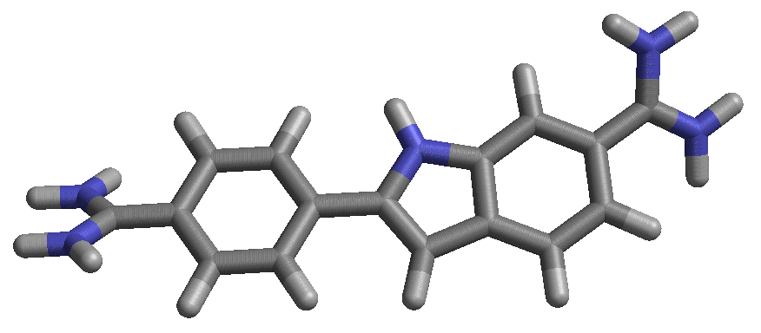
Minor groove binding modes of drugs to duplex DNA
DAPI: 4’,6-diamidino-2-phenylindole
DNA minor groove binder
antiparasitic, antibiotic, antiviral, anti-cancer
presumed MOA: blocking DNA binding
Goal: Insight into design or relative free energetics

Slide 45
Minor groove binding modes of drugs to duplex DNA
DAPI: 4’,6-diamidino-2-phenylindole
DNA minor groove binder
antiparasitic, antibiotic, antiviral, anti-cancer
presumed MOA: blocking DNA binding
2 minor groove binding modes:
d(CGCGAATTCGCG)₂
Larsen (Dickerson), 1989
d(GGCCAATTGG)₂
Vlieghe (Meervelt), 1999

Slide 46
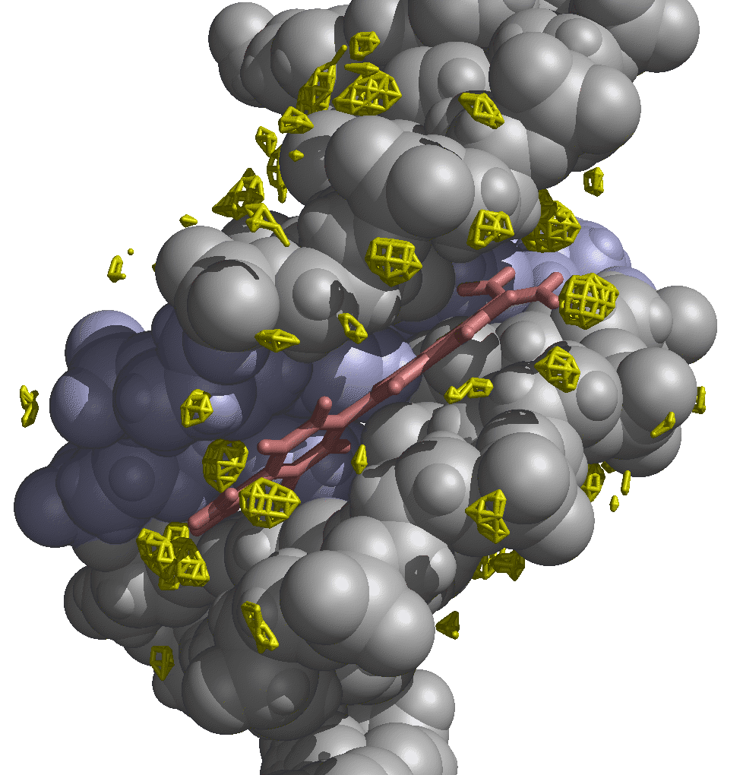
d(GGCCAATTGG)₂
yellow: hydration sites
consistent with crystal
less out-of-plane amido in guanine than expected

Slide 47
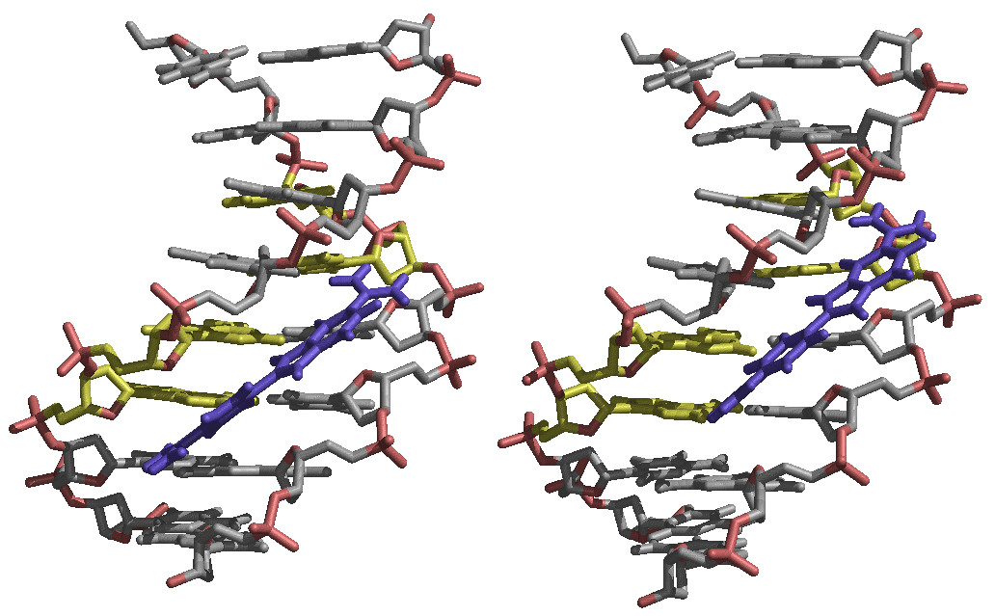
What happens if we shift the DAPI (ATTG ➔ AATT or AATT ➔ ATTG)?
(stable in MD simulation: shown are 5 ns average structures)

Slide 48
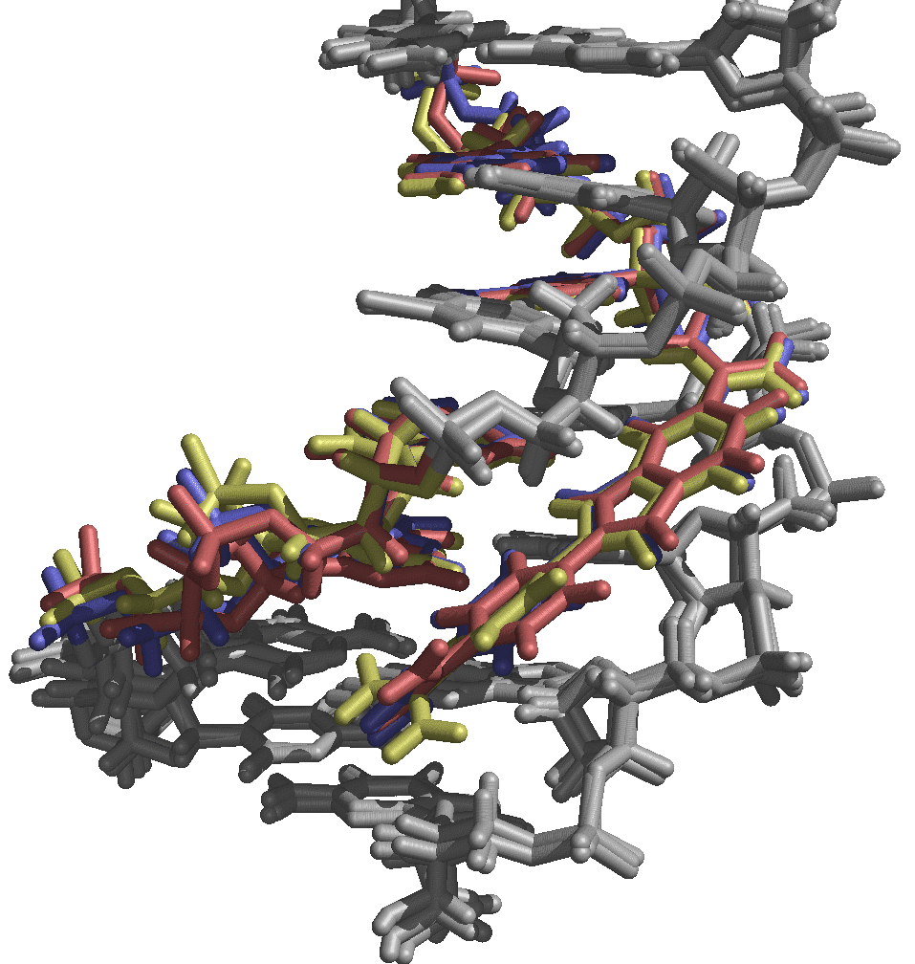
single trajectory free energy estimates
+ favors AATT
-- favors ATTG
site
DNA+dapi
DNA
DAPI
ΔG
ΔΔG
ΔΔG*
ATTG
-3860.3
-3689.6
-150.4
-20.3
+2.3
+0.7
AATT
-3864.9
-3691.4
-150.8
-22.6
ATTG
-3862.4
-3690.1
-150.3
-22.0
+3.3
-0.6 to 1.8
(includes entropy)
AATT
Note: solute entropic estimates
[rotational, translational, vibrational]
(of ~3-23 kcal/mol) not included
-3868.0
-3692.6
-150.0
-25.3
ATTG
-3865.7
-3693.4
-149.9
-22.5
+0.7
-3.2
AATT
-3870.6
-3697.6
-149.8
-23.2
Experimental ΔG binding ~ -10 kcal/mol

Slide 49
What about including some explicit water into analysis? Pitfalls:
continuum model may break down with explicit water
impossible to choose the explicit water in an unbiased manner
dynamics of water may lead to significant fluctuations
arbitrary thermodynamic cycle

Slide 50
What about including some explicit water into analysis?
continuum model may break down with explicit water
impossible to choose the explicit water in an unbiased manner
dynamics of water may lead to significant fluctuations
arbitrary thermodynamic cycle
Fluctuations No water 20 waters
electrostatics 37.7 41.8
van der Waals 8.7 10.1
internal 18.0 18.0
PB energy 34.2 37.2
G(DNA-dapi complex + 20 waters) – [ G(dapi) + G(DNA + 20 waters) ]

Slide 51
More consistent results if we include “bound” water: 20 closest waters to DAPI or minor groove atoms
site
E_{complex}
E_{DNA+20w}
DAPI
ΔG
ΔΔG*
ATTG
-4085.0
-3915.6
-149.7
-19.7
-2.4
AATT
-4086.4
-3917.9
-149.7
-18.8
ATTG
-4085.7
-3916.4
-149.7
-19.6
+1.0
* Includes entropy
AATT
-4087.5
-3917.2
-149.7
-20.6
ATTG
-4087.2
-3918.7
-149.7
-18.8
+1.4
AATT
-4092.8
-3922.9
-149.7
-20.2

Slide 52
Complications:
multiple binding modes,
conformational substates of DNA
need better balance of continuum parameters with MM force field
substate
ΔG
S1
-23.3
S2
-18.0
S3
-18.4

